Slide 1



Slide 2
FULL SEMESTER INTERNSHIP PROGRAMMES
Guidelines for preparing presentation for reviews
Prepare your presentation using the template given.
Title slide should be informative. (name, JNTU no, company name, name of faculty supervisor, name of industry supervisor)
Have one slide addressing outcomes of FSI (Engineering Knowledge, Problem Analysis, Modern Tool Usage, Ethics, Communication, Interpersonal skills and Team Work) whichever is applicable for the review.
Furnish details of the project work that has been assigned to you in the industry.

Slide 3
Learning management System using Web FrameWorks
Vihaan electrix, Vishakapatnam
By
R.Swapnique(19341A05E1)
P.l.S.S Tirumalesh(19341A05D0)
P. Krishna Vamsi(19341A05D2)
Industry Supervisor
Mr. N.Venkata Reddy
Faculty Supervisor
Mr.K.Lakshman Rao

Slide 4
ABSTRACT
The basic idea of developing a Learning Management System is to provide Variety of courses for the Students. we have given the necessary inputs on Developing a Responsive Learning Management System . Based on the First set of Inputs we have created two different frontend Models for the LMS and later on the further inputs we worked as a team to develop the model .A learning management system is a platform that assists an organization, and dimension of its eLearning programs. LMS is the core technology which is used by the department of Learning and Development in an organization, whereas the training programs are managed by their main tool. The largest benefit of LMS is the knowledge growth between learners. This saves money, since usual training forms such as classroom or seminars-based training directly impacts the company’s outcome.

Slide 5
Introduction
Vihaan Electrix runs an another branch called Teck Team Solutions it gives offline Seminars and also offers workshops to various institutions to Improve the technical knowledge to the students. It mainly works on trending technology and implements it. They want to make the following things online i.e to implement the LMS module . So we have used the basic frontend languages and a little bit of PHP for the front-end. And we used php , Django for the backend , and MySql for the database.
Problem Statement
Create a Responsive Learning Management System which contains basic pages like home page, courses page , about page and a login page . There should be two logins , One for the Users and other is for the Admin . The courses page should be visible for Everybody and to view the Course on has to Buy the course . For Users after payment the Courses should be able to Display and admin should be viewed everything and also he should be able to add the course and the course content.
.

Slide 6
Tools and Technologies Used
CSS
HTML
PHP
Java Script
Django

Slide 7
ABOUT WORK
Home Page:
The Home page is Responsive that it can be Viewed on any Tab.
By default, there will be 5 buttons which will redirect to the respective Pages.
We can view the entire page by scrolling down , this page contains a tab like it shows how many students have purchased this course and viewing the courses .
It contains a footer page with address and social media profiles .

Slide 8
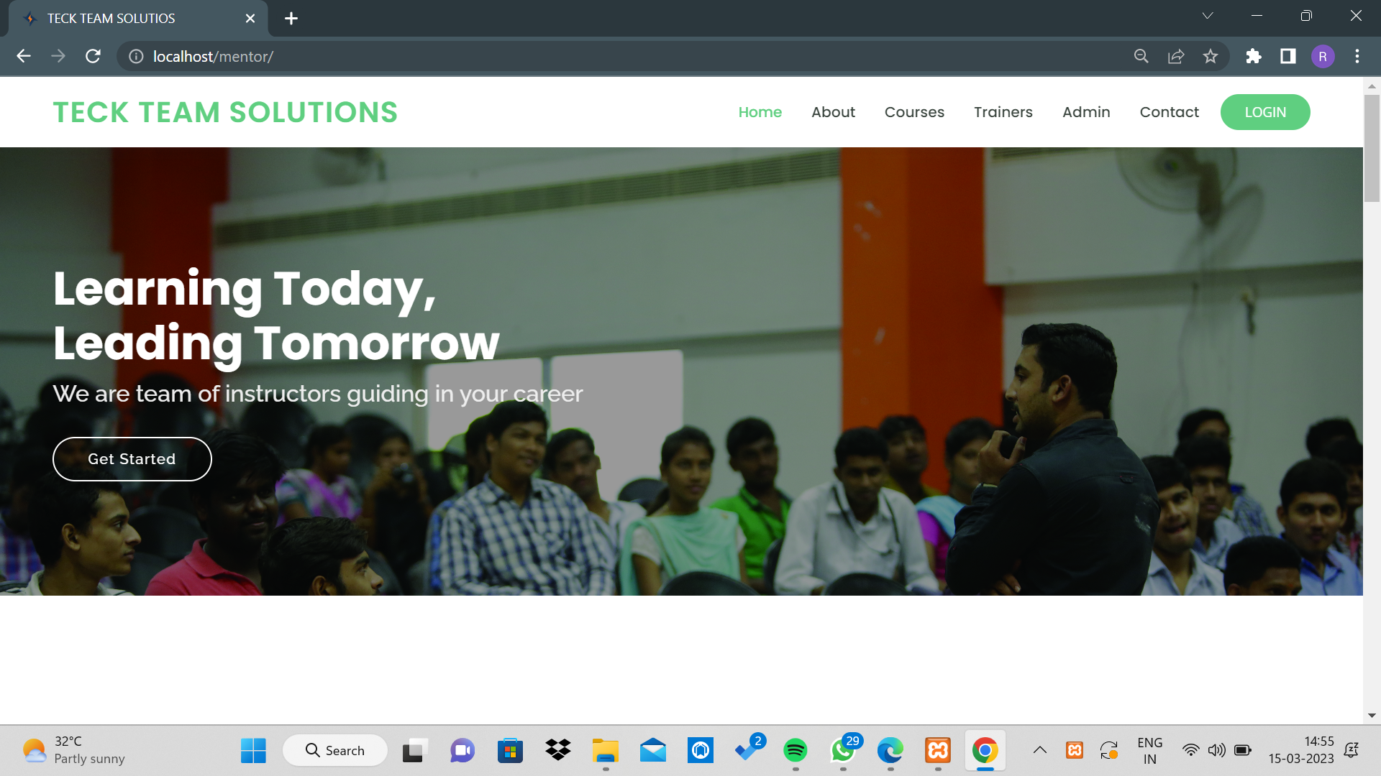

Slide 9
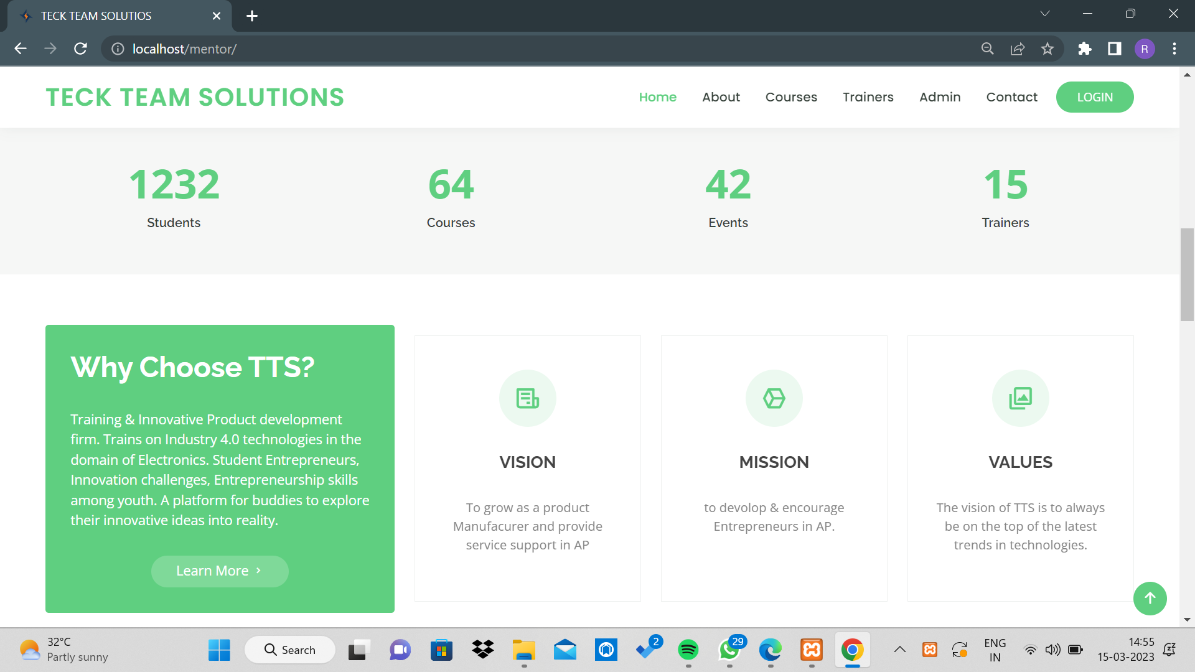

Slide 10
About page:
This page is about the company and their Feautres
It Describes about the Achievements done by the Company.
It contains Testimonals tab where we can view about the Company handlers and Officials .
At last it has the same Footer page .

Slide 11
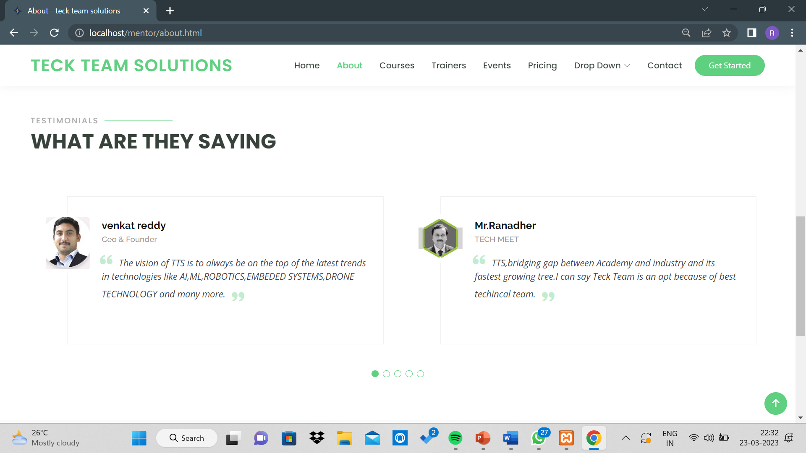

Slide 12
Courses page:
This page will Display the Courses .
We can view the the courses offered by the Company that we can learn.
By clocking on the partical course it will be directed to the Course description Page.
It will Describe about the Course in a short note .
After buyong the the Course only it Will Display the Full Content.

Slide 13
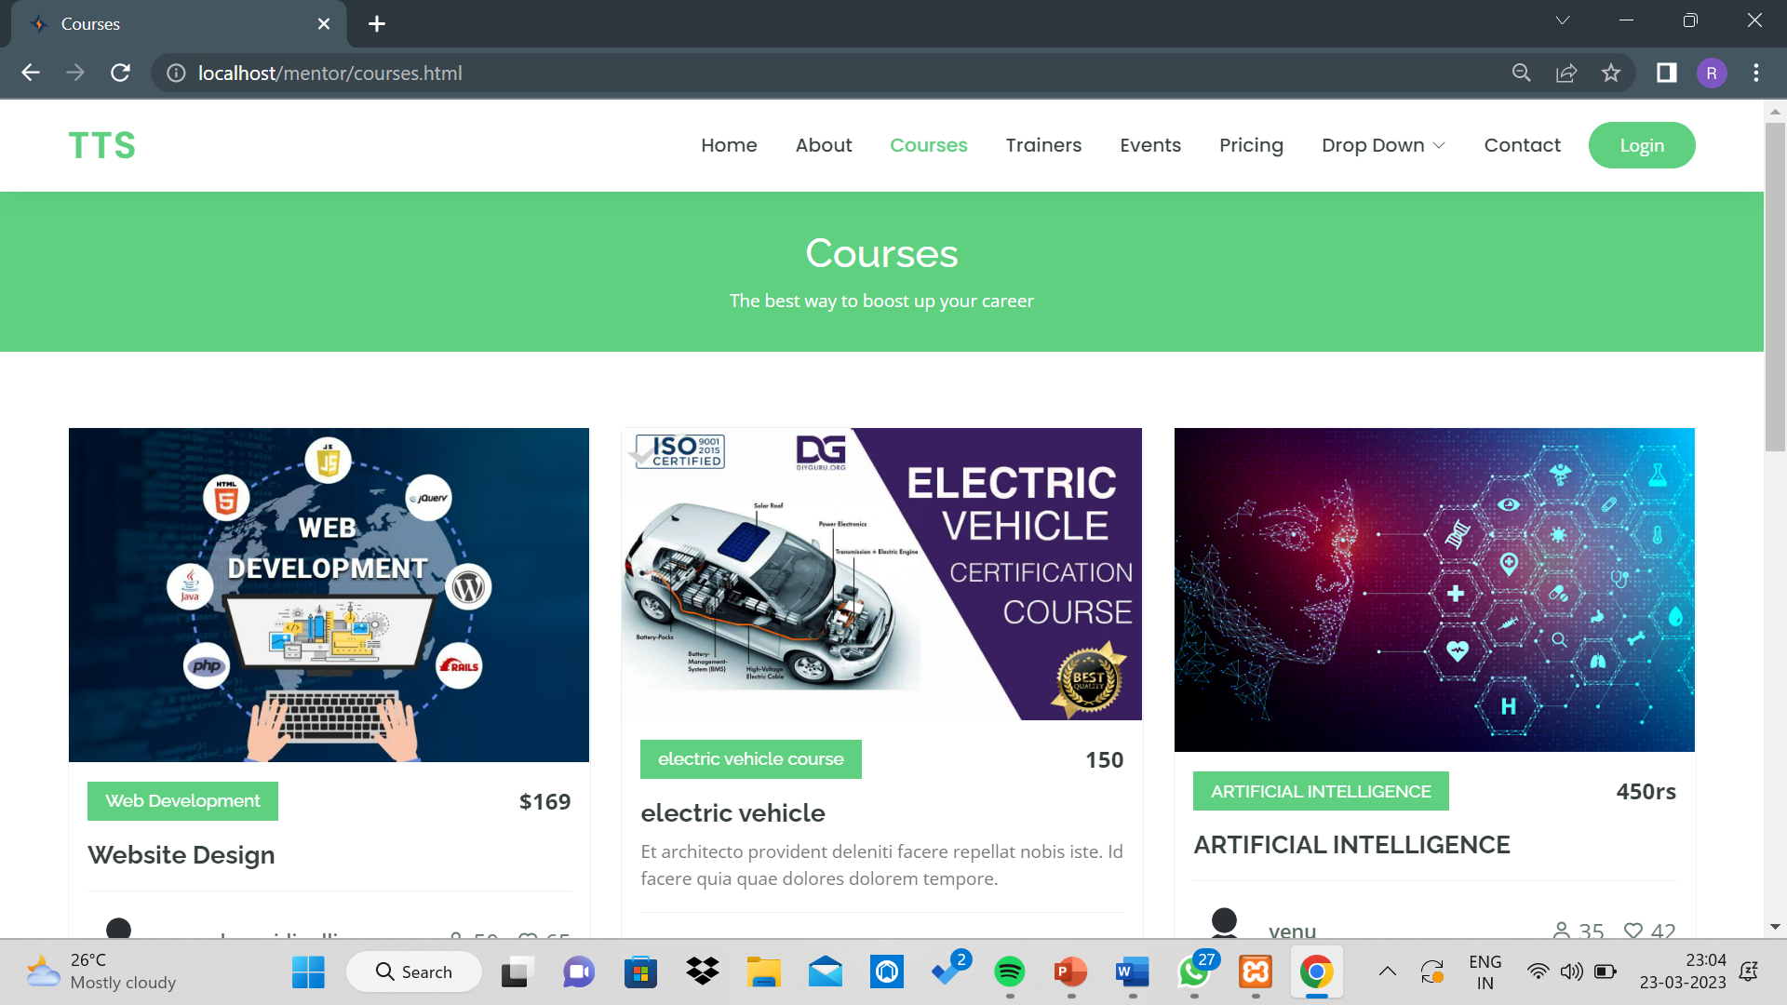

Slide 14
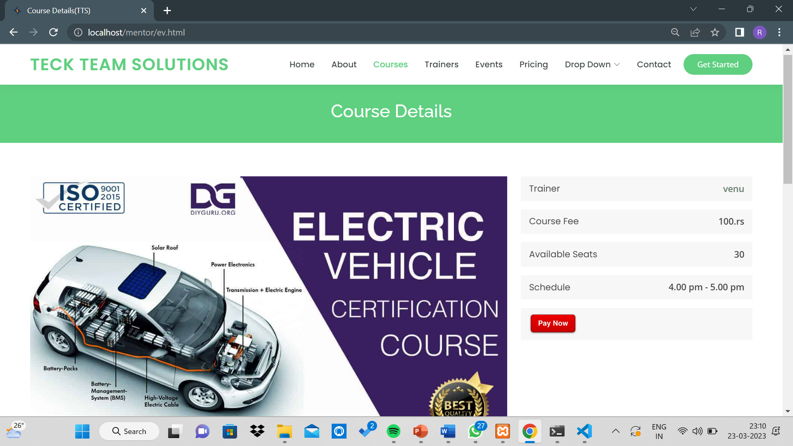

Slide 15
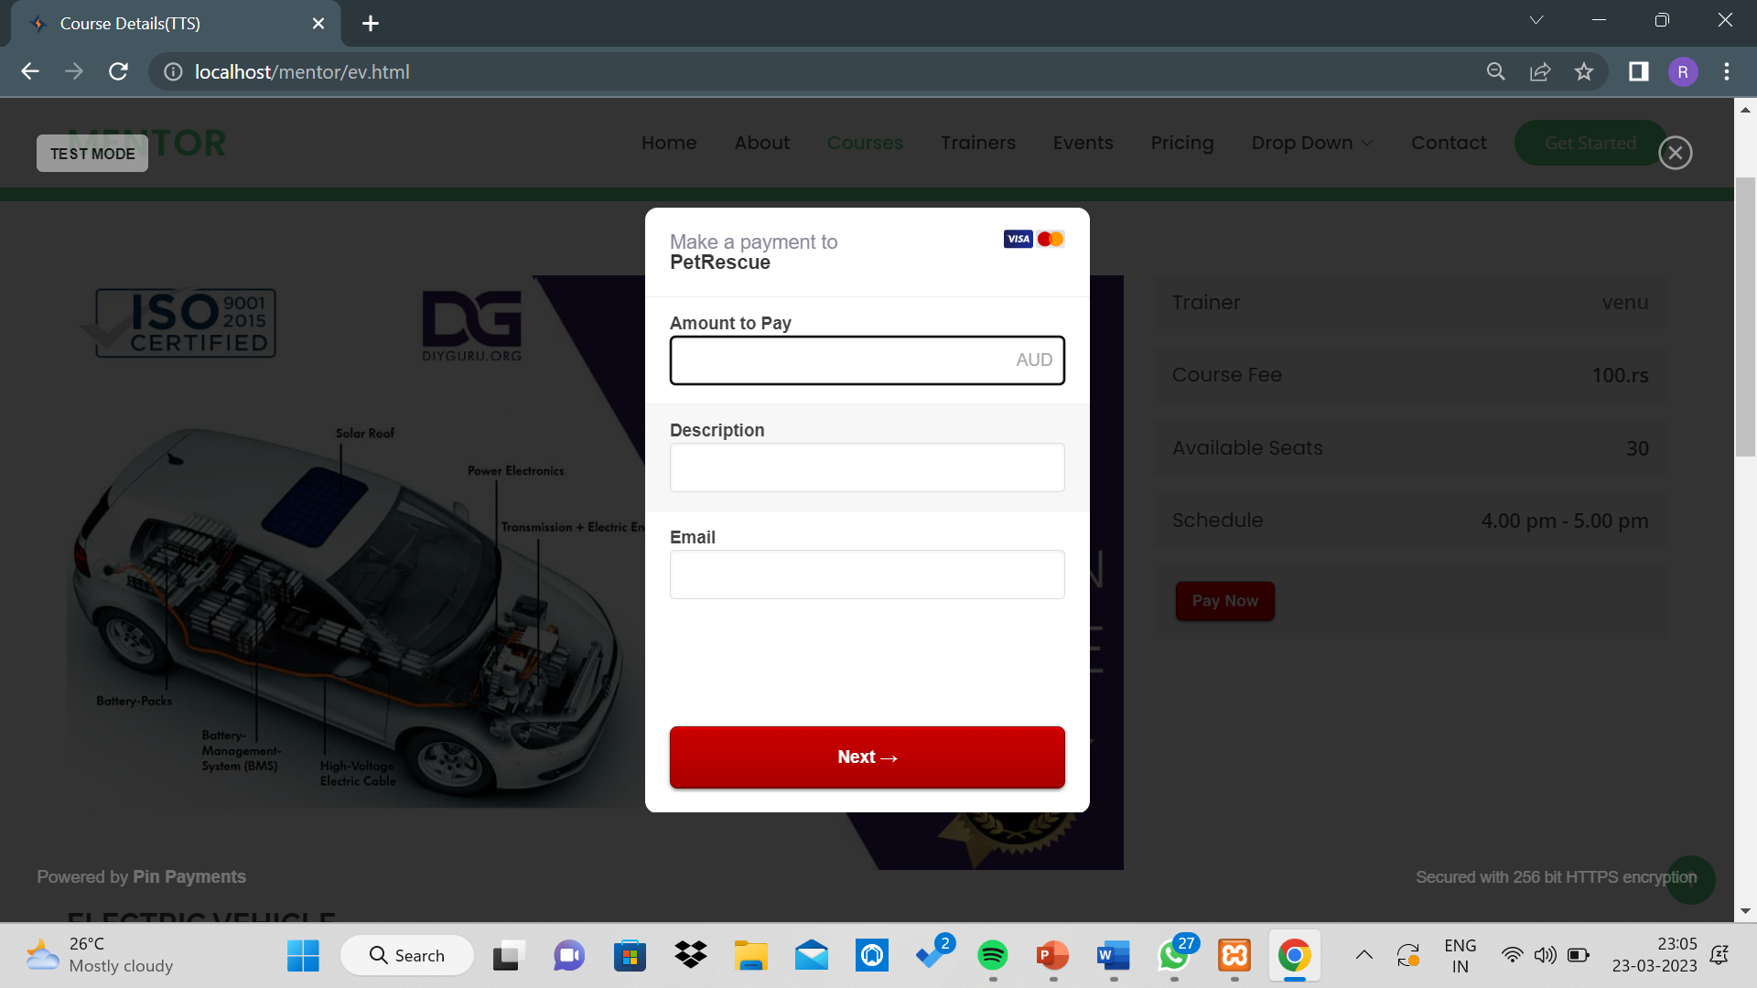

Slide 16
Login Page:
it will basic login details .
After entering the details it will redirected to the courses page .
If the user details are incorrect the it will give the error Statement.

Slide 17
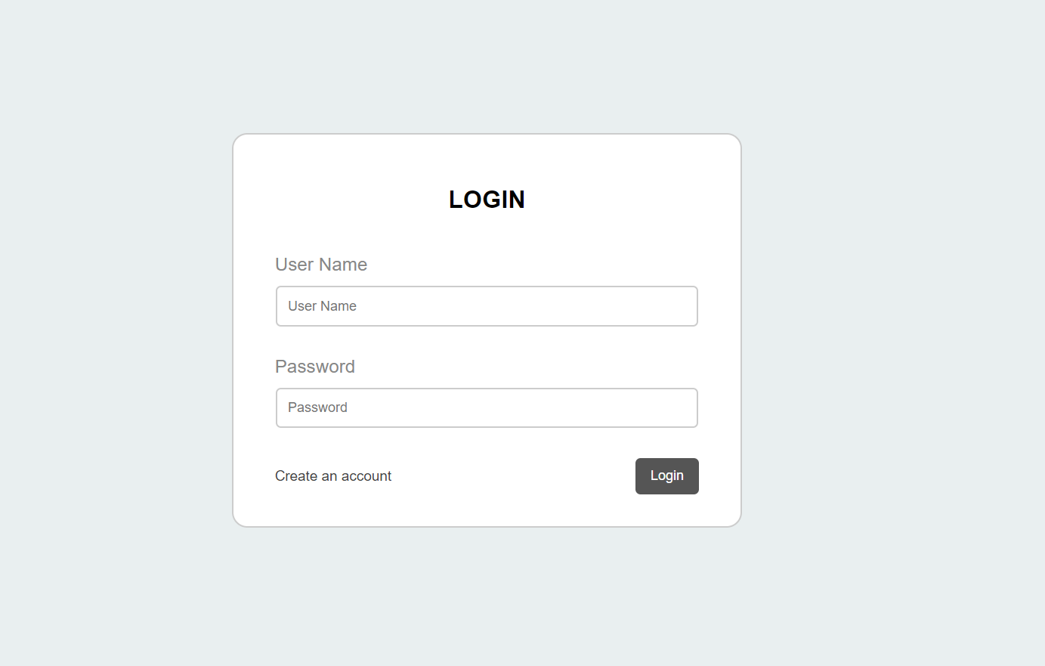

Slide 18
Registration page:
it will basic registration details like Name ,User Name , password . .
After entering the details the details will be registered.
We can redirect to login if we know the details .

Slide 19
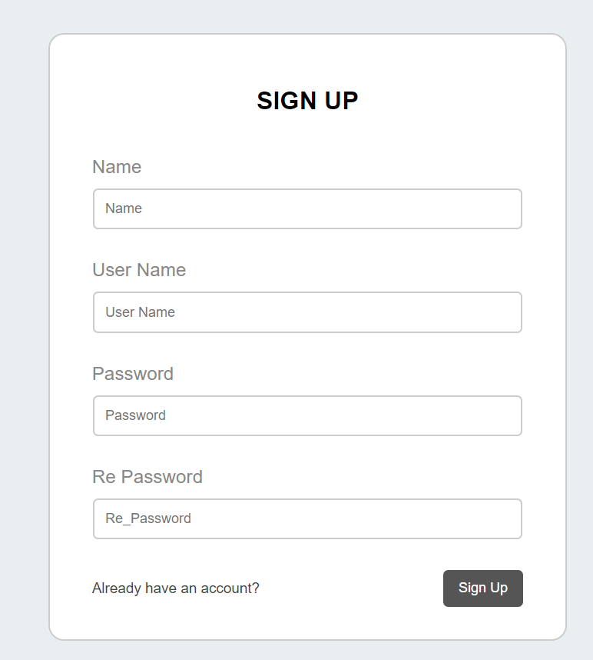
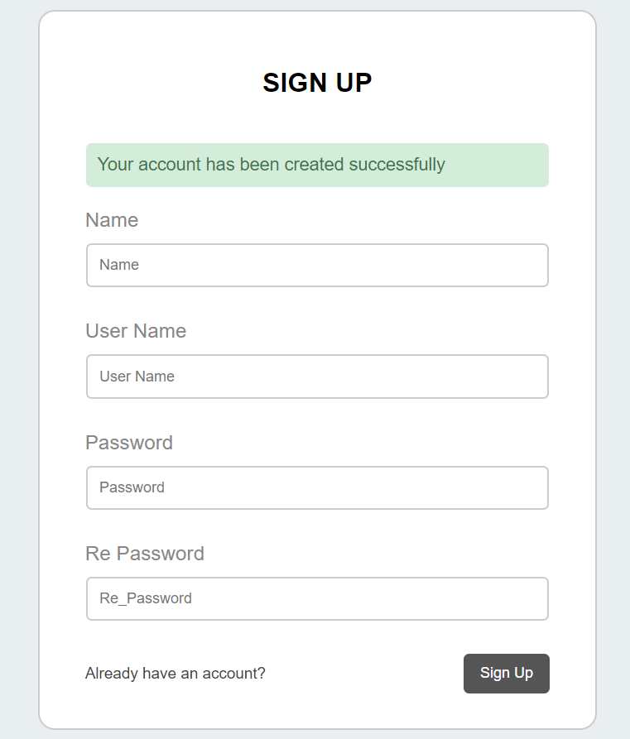

Slide 20
1. Company Name & Logo
From the top left the user is able to see the company name and logo of the org that is given on the org creation page.
if we click on the company logo then it will redirect to the home page directly.
2. Theme Toggle
Users should be able to switch between light and dark themes using the toggle in the menu bar on the top of the page.

Slide 21
3. Home Icon in the menu bar
On clicking this icon in the menu bar on the top of the Page, users should be able to see three options as follows:
Popular courses
Latest courses
Teachers
Three modules are completely different in that they are used for showing popular courses and ratings and reviews of a courses
4. User :
On clicking the User in the navbar user should be able to see a drop-down with the following options:
login
Register
Dashboard
Logout

Slide 22
when we click on the login button it will redirect to the login page.
When we click on the register page it will redirect to the registration page.
When we click on the dashboard it will go to the page and there we can change or move to another org.
Log-out option is available whenever the user wants to sign off from the account there is an option provided in the header.
5. Teacher dashboard:
On clicking the Teacher dashboard Menu, the user should be able to see another page with the following options:
my courses
Add courses
My users
Profile settings
Change password
Log out

Slide 23
6. My courses
We can add courses or delete courses in this module
Add button
Delete button
How many members enrolled
views
By using add and delete operations we can add chapters in any course the teacher.
Add courses :
In this, we can categorize courses like python, java, php…etc.
Adding titles to the courses.
Adding descriptions to the courses.
Featured images are uploaded by the teachers for every course.
Submit button.

Slide 24
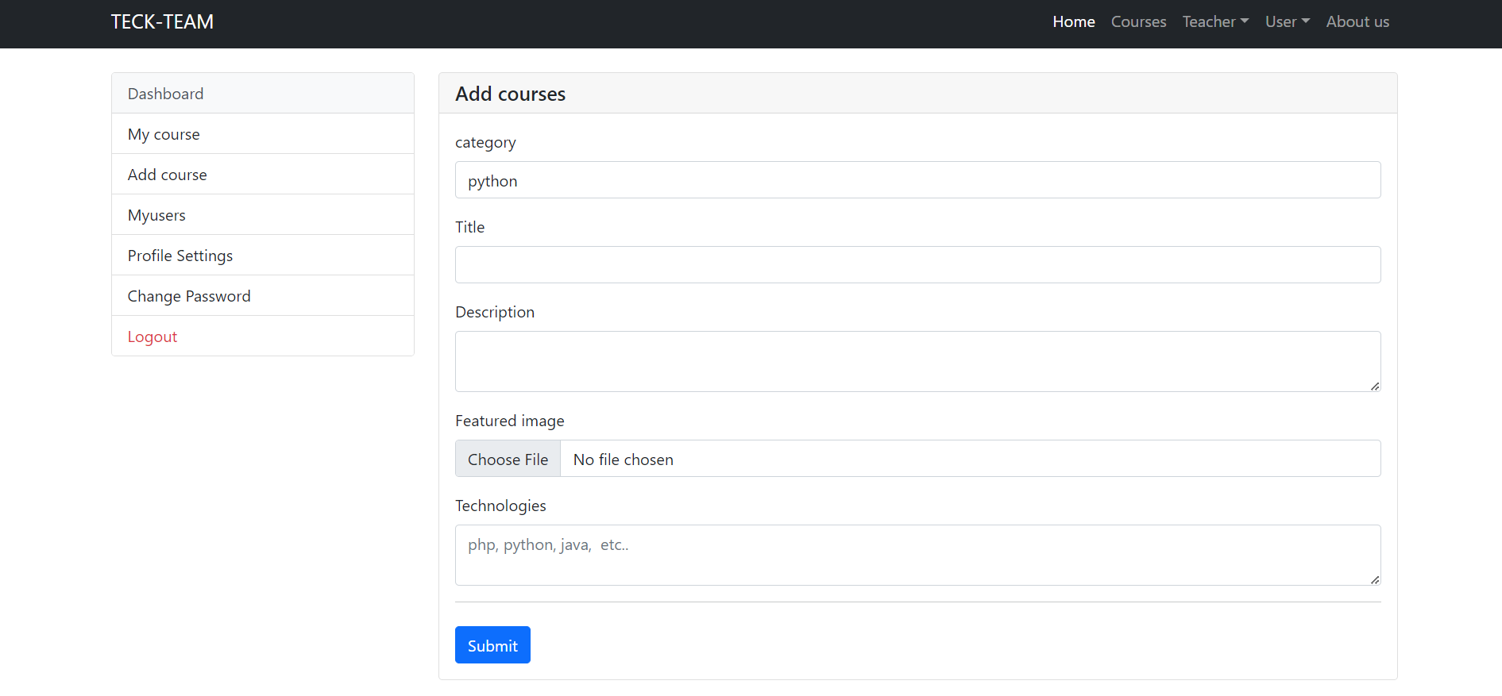

Slide 25
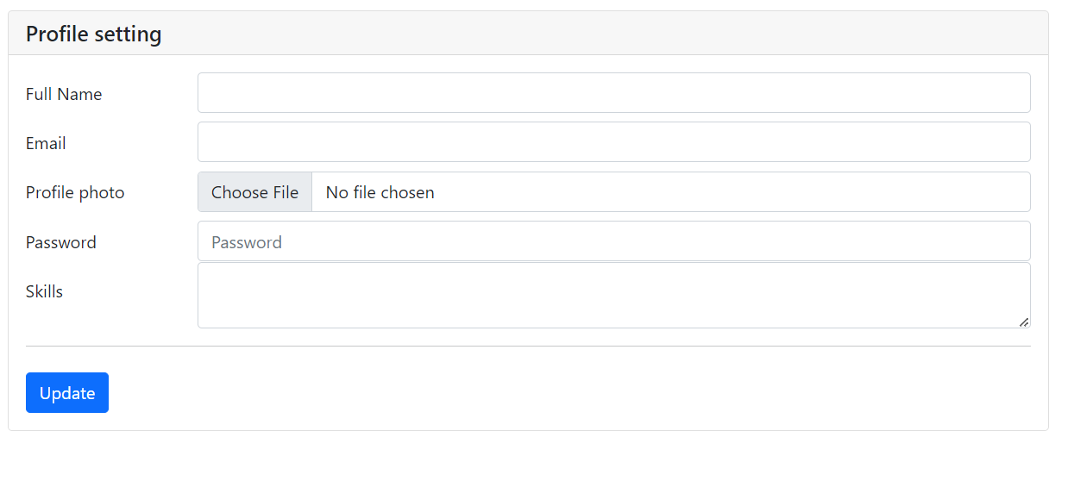
7. profile setting
There should change their profiles on this page.

Slide 26
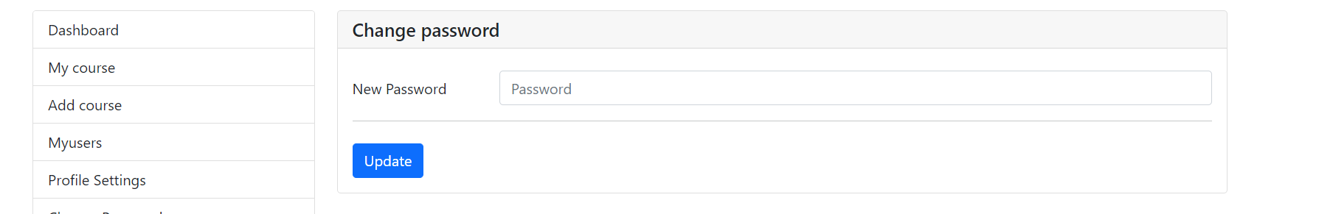
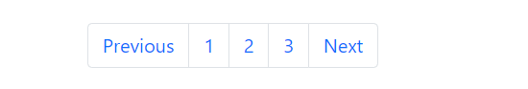
8. Change password:
In this we can change the profile password and create a new password and update.
Users should be able to scroll down the page until all the sections are displayed.
10. Paginations
Instead of a Scroll Bar, users should be able to scroll the page right from the page itself.

Slide 27
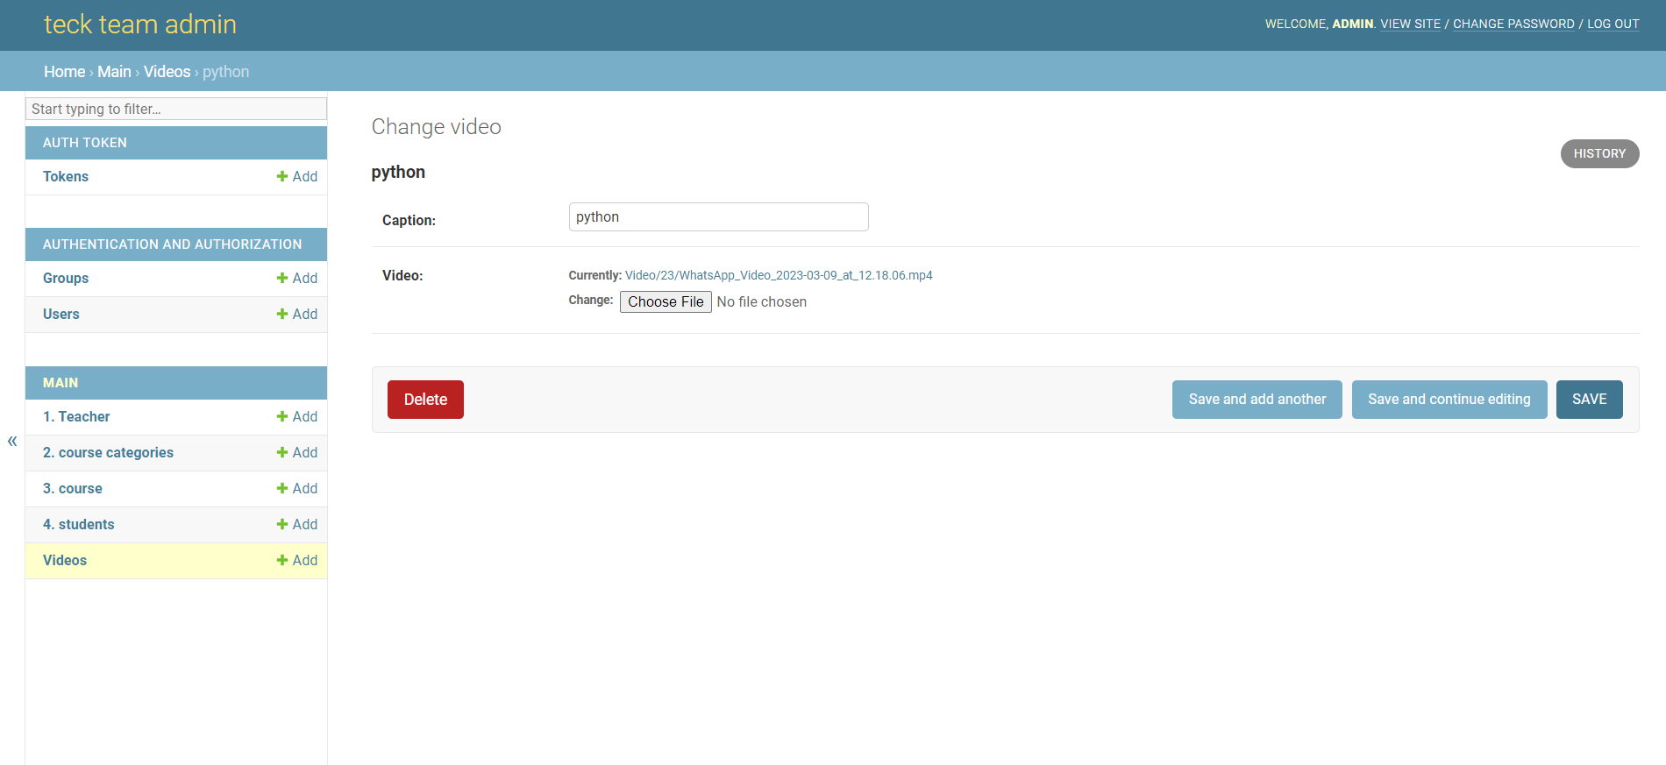
Upload a video:
Here in uploading a video, it is capable of applying the video only, it cannot be able to apply any pdf, mp3, or jpeg. Here we are able to see the cross icon and upload video icon which will be very useful for the user experience.
When we try to upload a video if it has been uploaded successfully then below a button or go to video details will be available in which if we click on that button will be redirected to the video details page.
Videos are uploaded through the admin panel only.

Slide 28
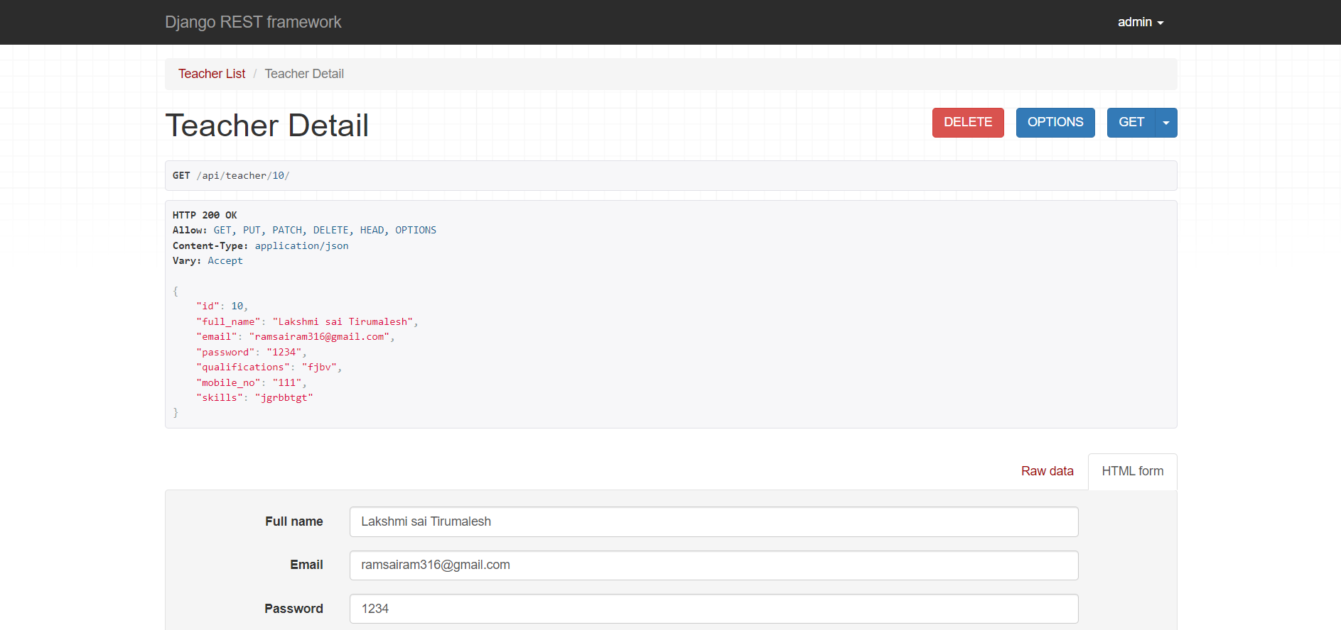
Teacher registration :
After clicking on the teacher registration it will be directed to the registration page.
By filling out the registration form the data will be fetched to the Django rest framework.
In Drs, it will store the data using IDs so that we can easily search for any student or teacher data.
It can perform crud operations in the Django rest frame work.

Slide 29
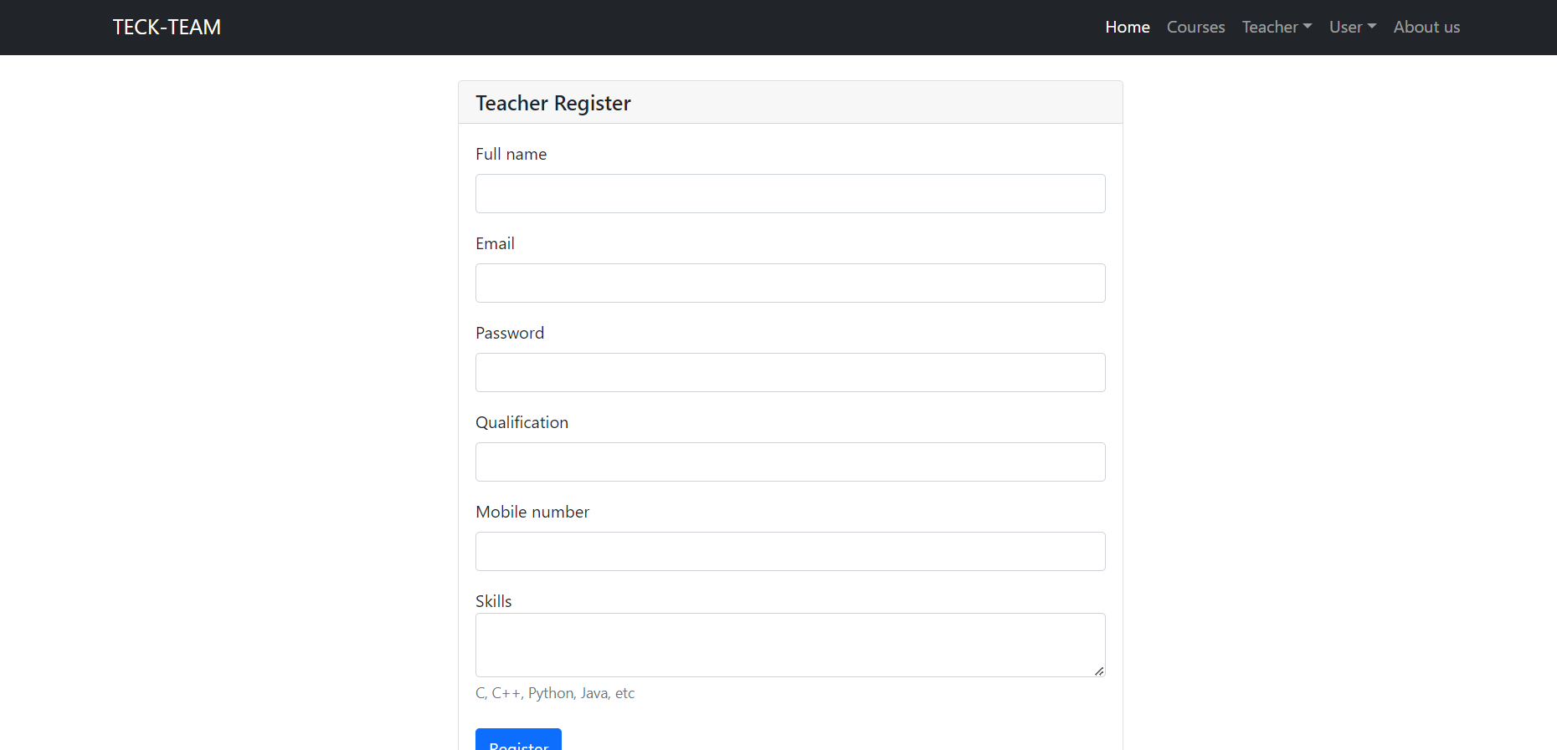

Slide 30
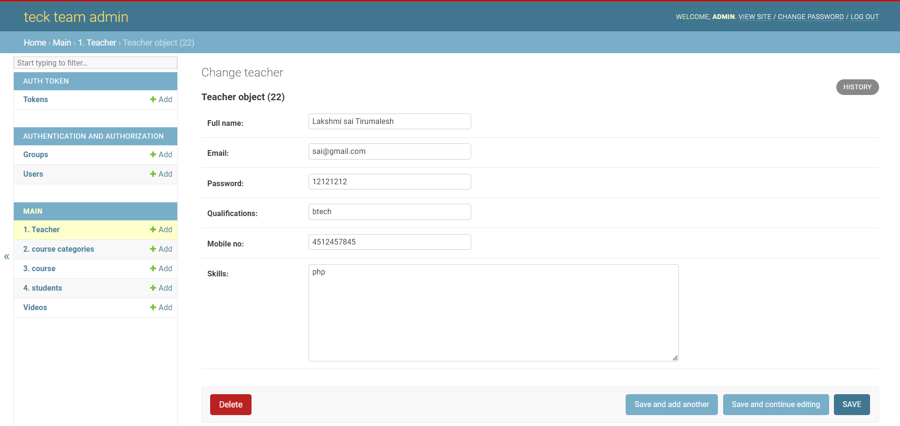

Slide 31
Thank You

